Slide 1
Graph Analytics
Li, Jia
DSAA 5002
HKUST Guangzhou
2025 Fall
Oct 13
Notes:
This part is even more important than all the other material in this course, if you are in the industries. 80% of your efforts will be poured into data preprocessing, rather than design or improve algorithms, given most of the model work are based on mature components such as decision tree, logistic regression, and so on and so force.

Slide 2
Content
Graph Basics
Node Importance
Community Detection
Influence Propagation
Graph Spectral Theory

Slide 3
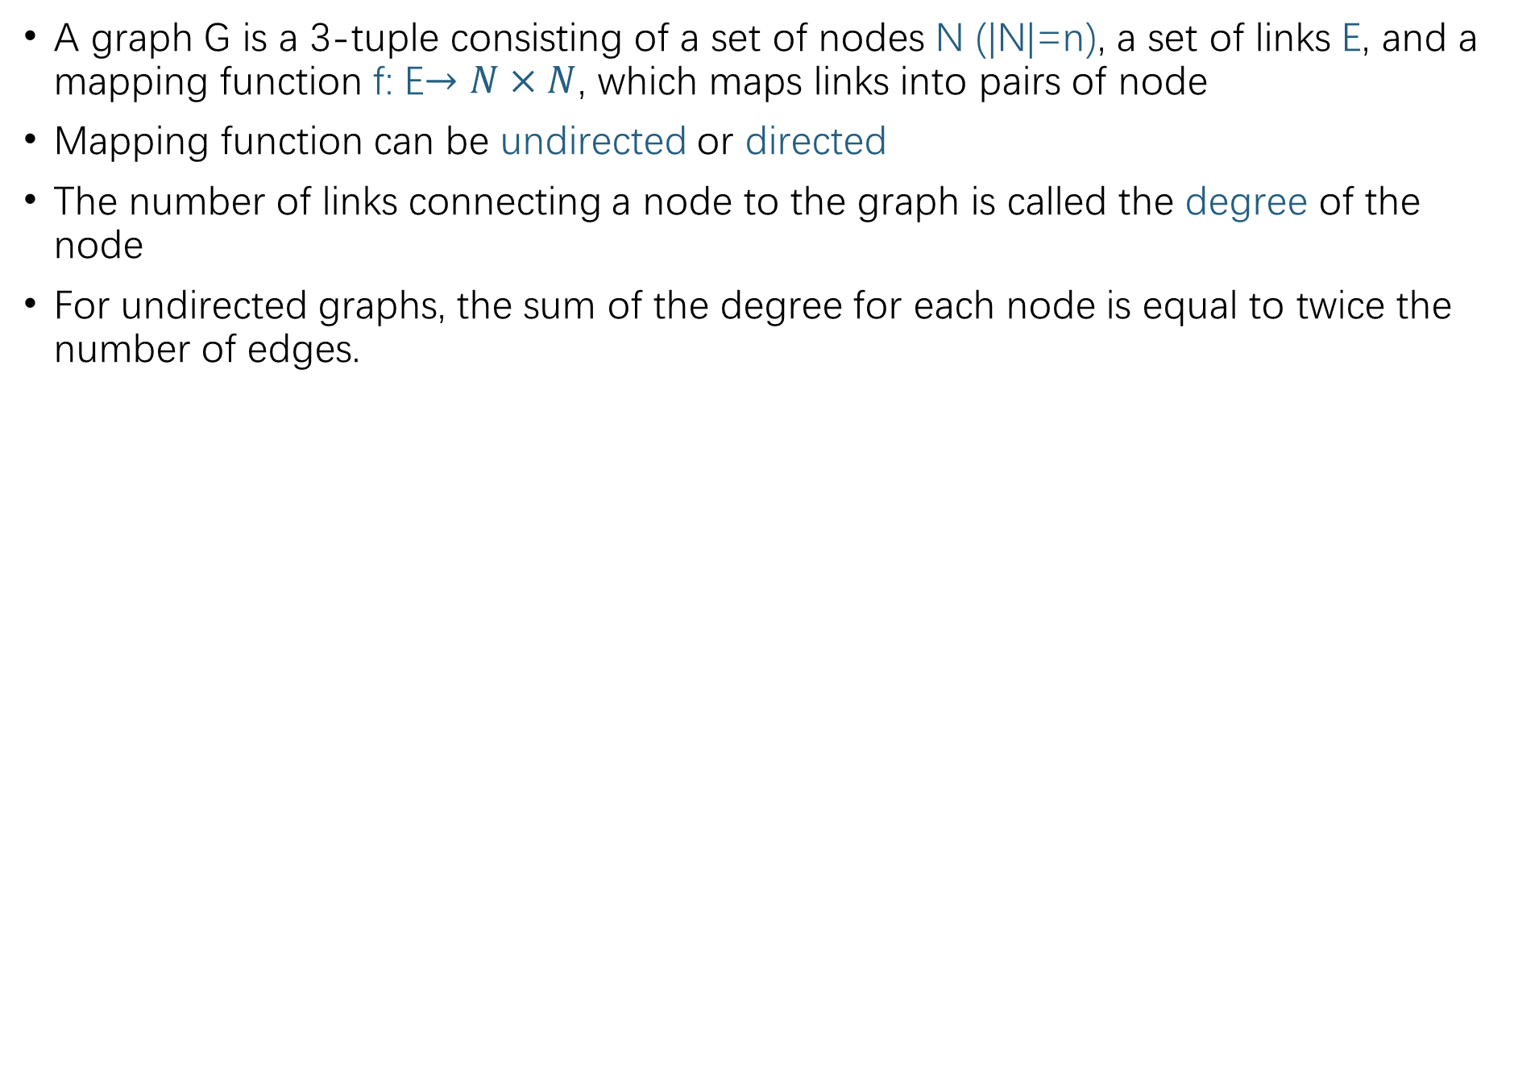
Basics
A graph G is a 3-tuple consisting of a set of nodes N (|N|=n), a set of links E, and a mapping function f: E$→N×N$, which maps links into pairs of node
Mapping function can be undirected or directed
The number of links connecting a node to the graph is called the degree of the node
For undirected graphs, the sum of the degree for each node is equal to twice the number of edges.
Notes:
transaction graph, node ,edge; IP, Device, phone NO,etc

Slide 4
Basics
A walk is an adjacent node sequence in G.
A path is a walk without repeated nodes.
The length of a path is equal to the number of links (hops) between starting and ending nodes of the path.
The longest shortest path between any two nodes is called the diameter of G.
The longest shortest path from a node u to all other nodes is called the radius of node u.
Notes:
transaction graph, node ,edge; IP, Device, phone NO,etc

Slide 5
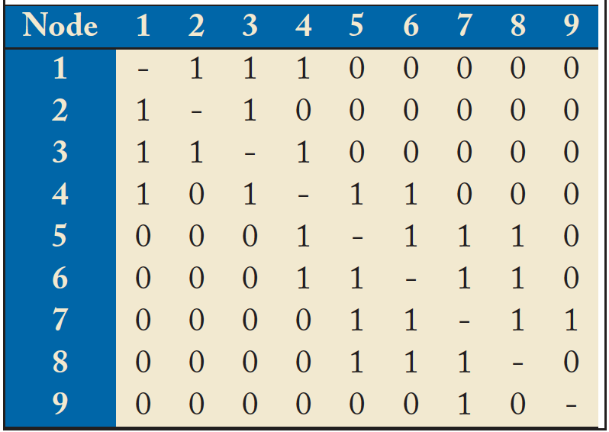
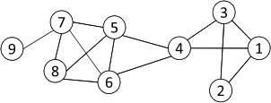
Basics
An adjacency matrix A is a square matrix whose elements indicate whether pairs of nodes are adjacent or not in a graph, i.e., (0,1) matrix.
The Laplacian matrix L of graph G is a combination of the adjacency matrix and degree matrix: L = D- A, where D is the degree matrix.
Notes:
transaction graph, node ,edge; IP, Device, phone NO,etc

Slide 6
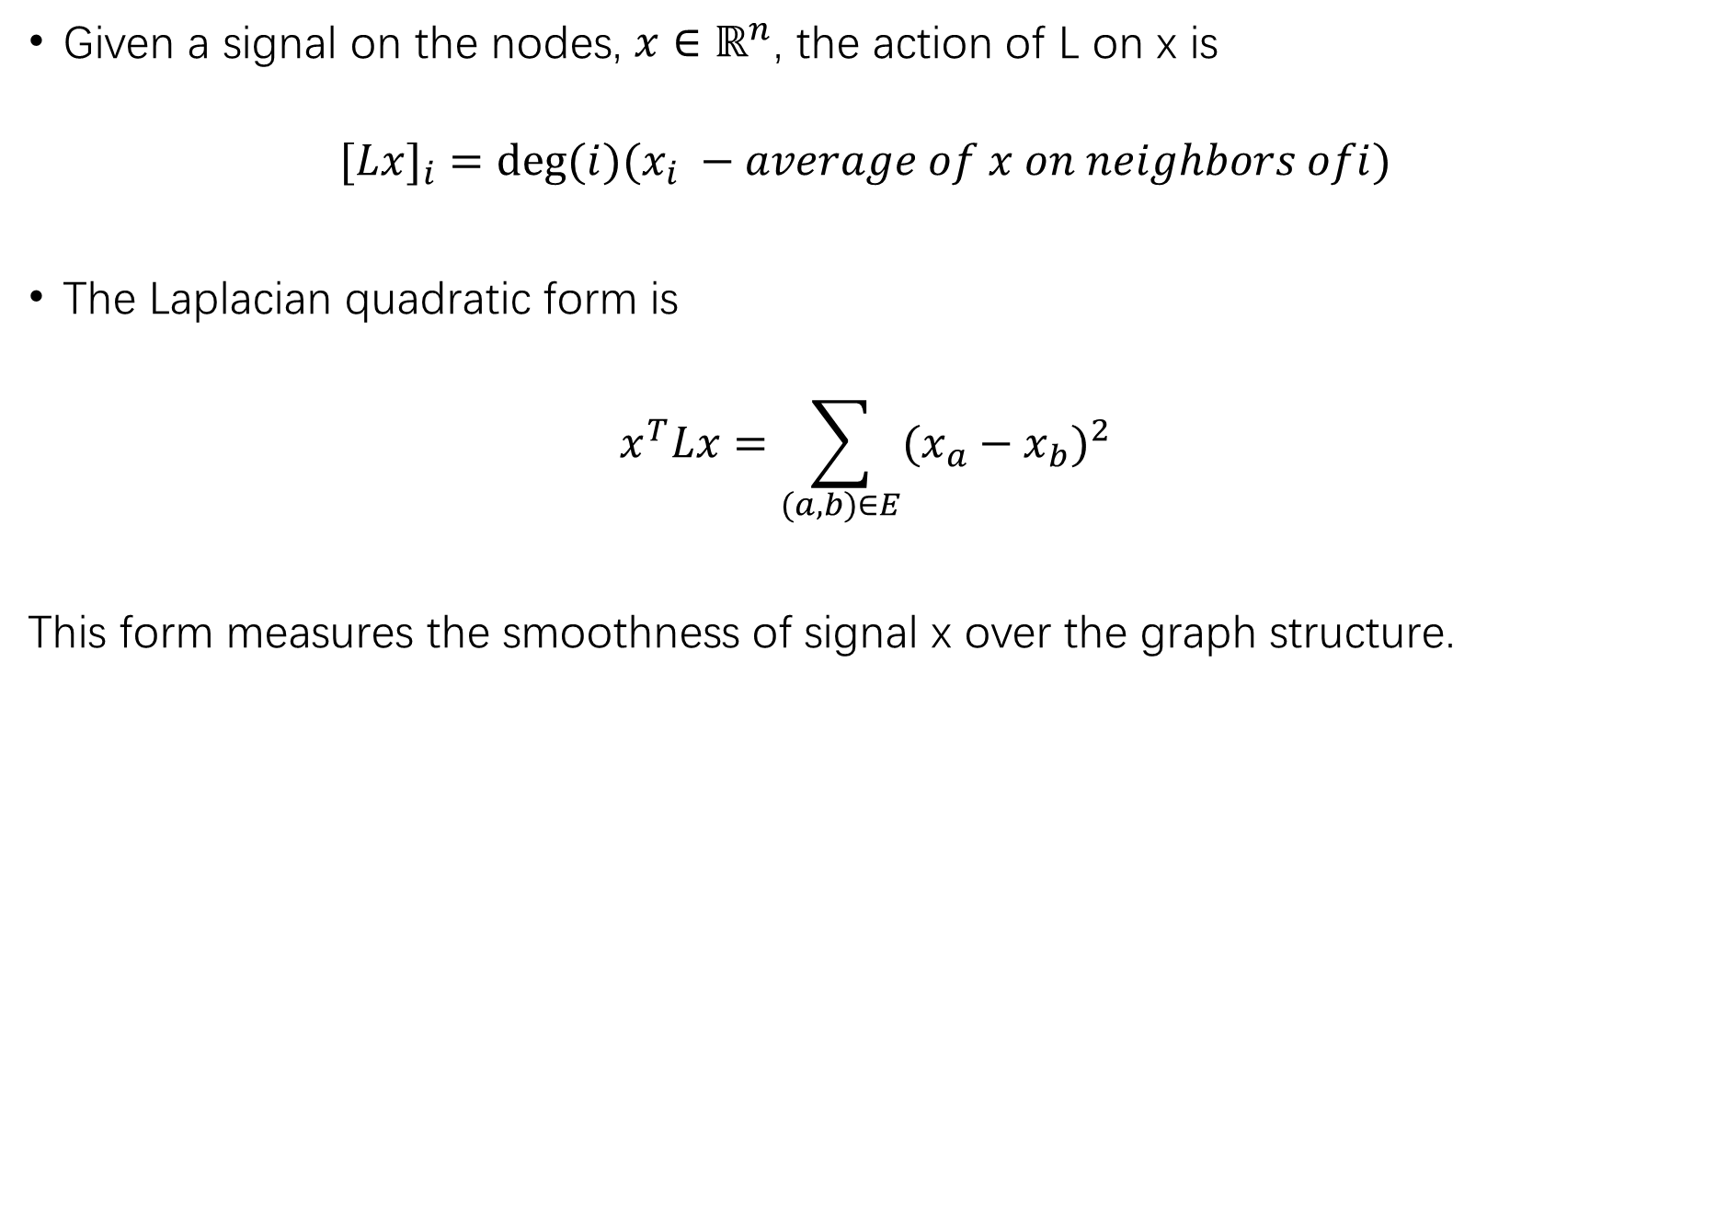
Basics
Given a signal on the nodes, $x∈ℝ^{n}$, the action of L on x is
$$[L{x]}_{i}=deg⁡(i)(x_{i} −average of x on neighbors ofi)$$
The Laplacian quadratic form is
$$x^{T}Lx=\sum_{(a,b)∈E}{(x_{a}−x_{b}})^{2}$$
This form measures the smoothness of signal x over the graph structure.

Slide 7
Node Importance

Slide 8
Node Importance
Not all nodes are equally important
Find out the most important nodes (influential entities) in one network
Commonly-used measures
Degree Centrality
Closeness Centrality

Slide 9
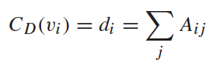
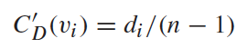
Degree Centrality
The importance of a node is determined by the number of nodes adjacent to it
The larger the degree, the more important the node is
Only a small number of nodes have high degrees in many real-life networks
Degree Centrality
Normalized Degree Centrality:

Slide 10
Degree Centrality Example
Which node is the most important in the network?
Node | Degree centrality | Normalized degree centrality
1 | 3 | 3/8
2 | 2 | 2/8
3 | 3 | 3/8
4 | 4 | 4/8
5 | 4 | 4/8
6 | 4 | 4/8
7 | 4 | 4/8
8 | 3 | 3/8
9 | 1 | 1/8
Non-linear Kernel

Slide 11
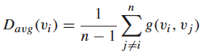
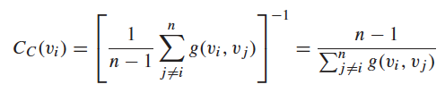
Closeness Centrality
“Central” nodes are important, as they can reach the whole network more quickly than non-central nodes
Importance measured by how close a node is to other nodes
Average Distance:
Closeness Centrality

Slide 12
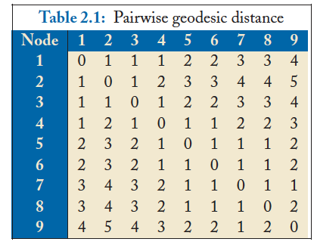
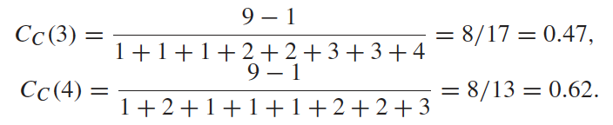
Closeness Centrality Example
Q
Node 4 is more central than node 3

Slide 13
Community Detection

Slide 14
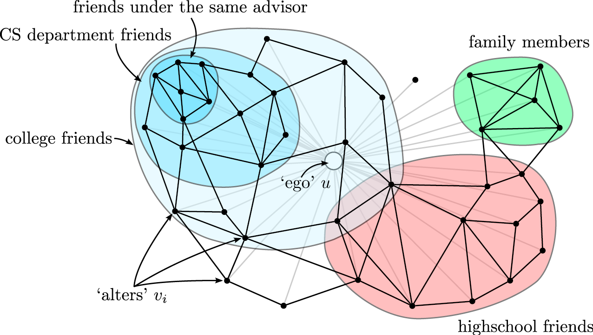
Community Detection

Slide 15
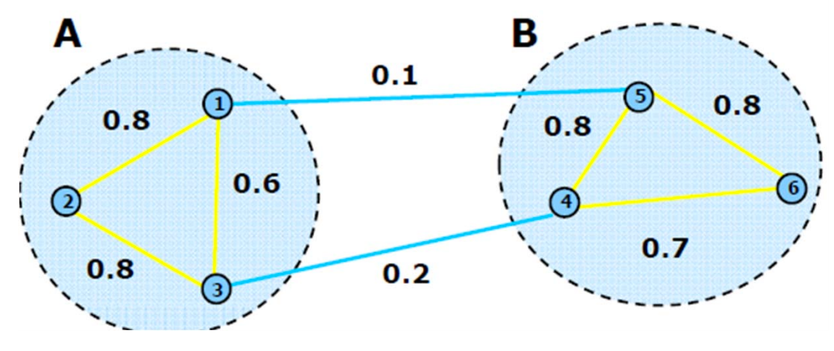
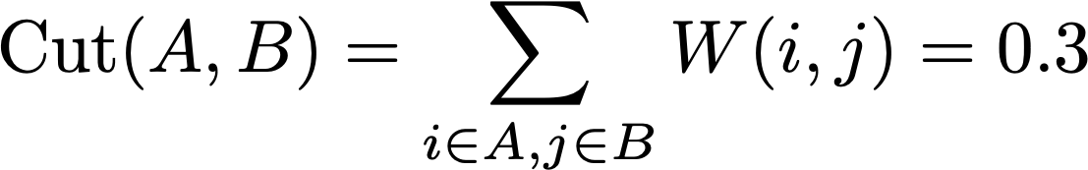
Graph Cut
Consider a partition of the graph into two parts A and B
Cut(A, B) is the weight of all edges that connect the two groups
An intuitive goal is to find a partition that minimizes the cut
min-cuts in graphs can be computed in polynomial time

Slide 16
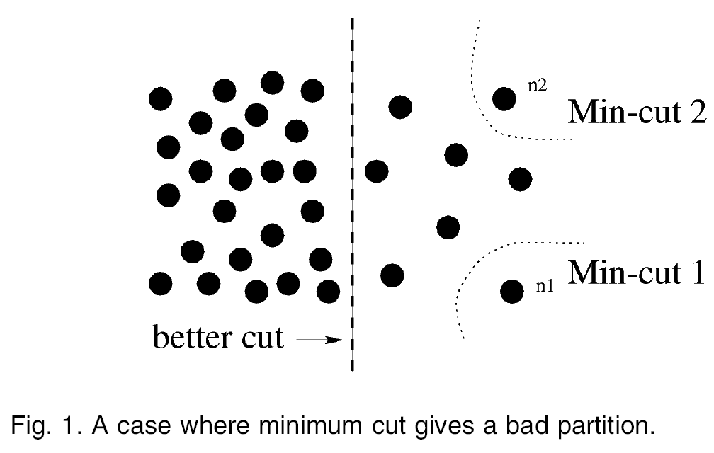
Graph Cut
The weight of a cut is proportional to number of edges in the cut; tends to produce small, isolated components.
[Shi & Malik, 2000 PAMI]

Slide 17
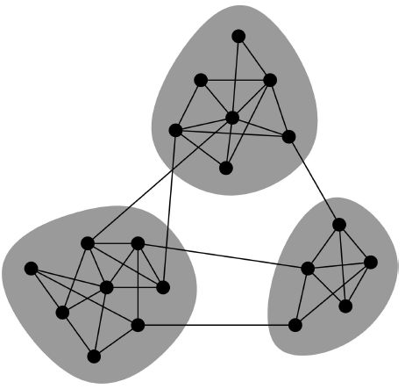
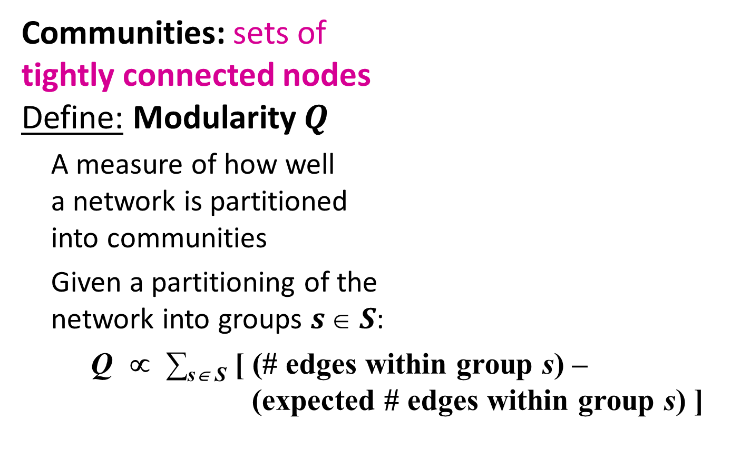
Modularity
Communities: sets of tightly connected nodes
Define: Modularity $Q$
A measure of how well a network is partitioned into communities
Given a partitioning of the network into groups $s  S$:
Q ∝ ∑_{s∈ S} [ (# edges within group s) – (expected # edges within group s) ]

Slide 18
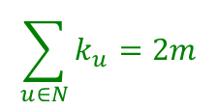
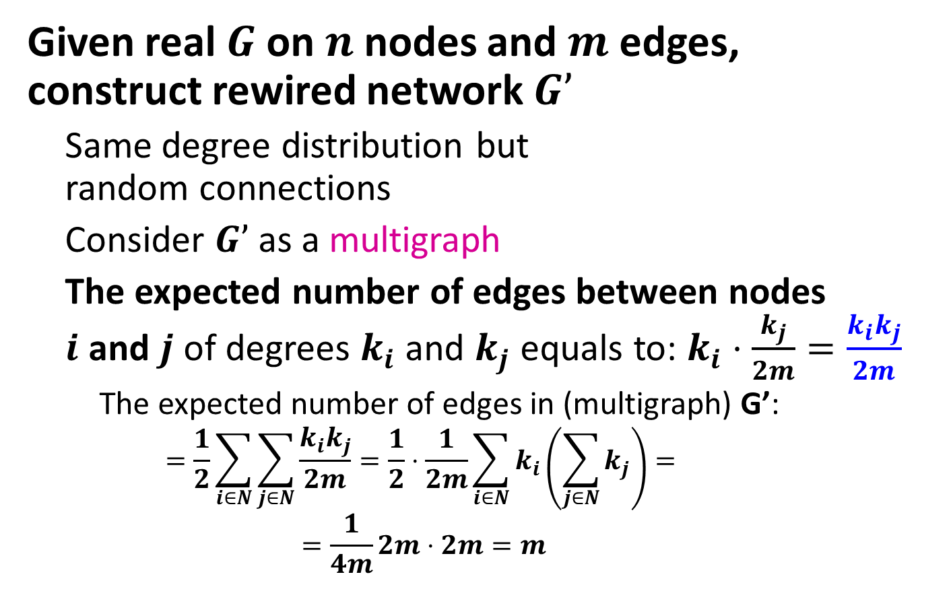
Modularity
Given real $G$ on $n$ nodes and $m$ edges, construct rewired network $G’$
Same degree distribution but random connections
Consider $G’$ as a multigraph
The expected number of edges between nodes $i$ and $j$ of degrees $k_{i}$and $k_{j}$ equals to: $k_{i}⋅\frac{k_{j}}{2m}=\frac{k_{i}k_{j}}{2m}$
The expected number of edges in (multigraph) G’:
$$=\frac{1}{2}\sum_{i∈N}{\sum_{j∈N}{\frac{k_{i}k_{j}}{2m}}}=\frac{1}{2}⋅\frac{1}{2m}\sum_{i∈N}{k_{i}\left(\sum_{j∈N}{k_{j}}\right)}=$$
$$=\frac{1}{4m}2m⋅2m=m$$
Non-linear Kernel
i
j
Note:
$$\sum_{u∈N}{k_{u}}=2m$$

Slide 19
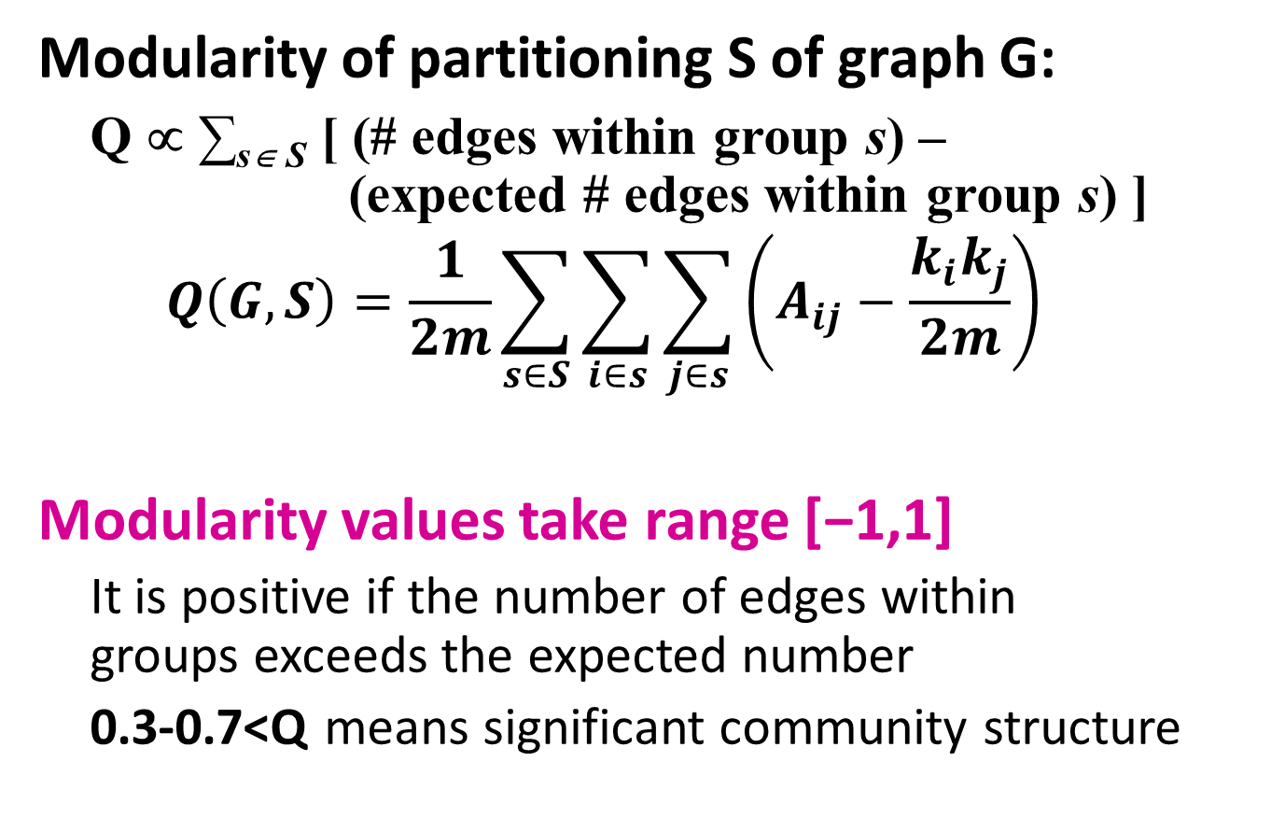
Modularity
Modularity of partitioning S of graph G:
Q ∝ ∑_{s∈ S} [ (# edges within group s) – (expected # edges within group s) ]
$$Q\left(G,S\right)=\frac{1}{2m}\sum_{s∈S}{\sum_{i∈s}{\sum_{j∈s}{\left(A_{ij}−\frac{k_{i}k_{j}}{2m}\right)}}}$$
Modularity values take range [−1,1]
It is positive if the number of edges within groups exceeds the expected number
0.3-0.7<Q means significant community structure
A_{ij} = 1 if i→j, 0 else
Normalizing cost.: -1<Q<1

Slide 20
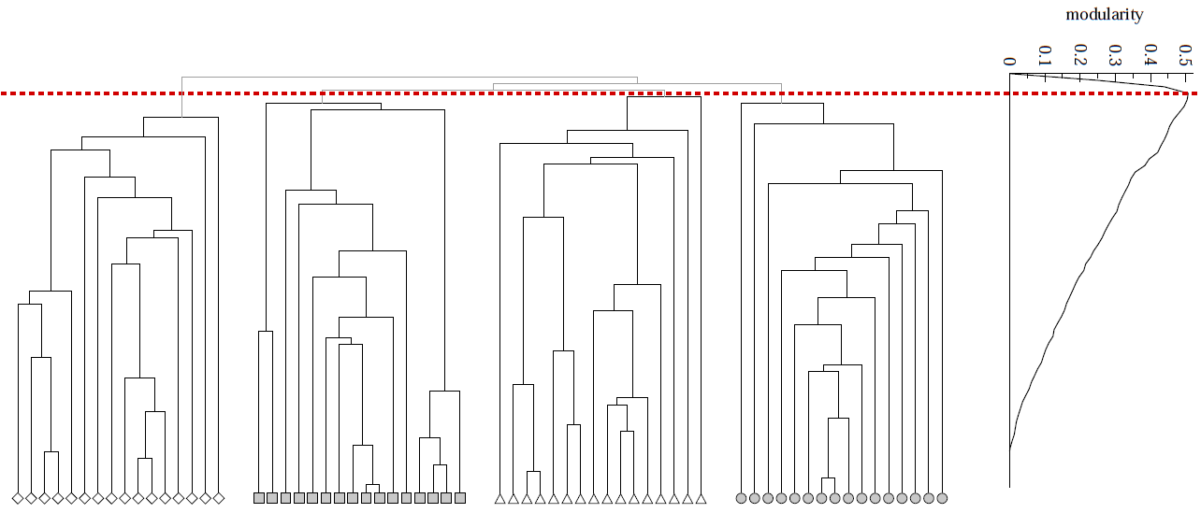
Modularity
Modularity is useful for selecting the number of clusters:
Q
Next time: Why not optimize Modularity directly?

Slide 21
Influence Propagation

Slide 22

Influence Propagation
People are connected and perform actions.
friends, fans, comment, link, rate,
followers, etc. like, retweet, post a
message, etc.
[Castillo et al., KDD’12]

Slide 23

Real World Example
Hotmail’s viral climb to the top spot (90s): 8 million users in 18 months!
Far more effective than conventional advertising by rivals and far cheaper too!
[Castillo et al., KDD’12]

Slide 24
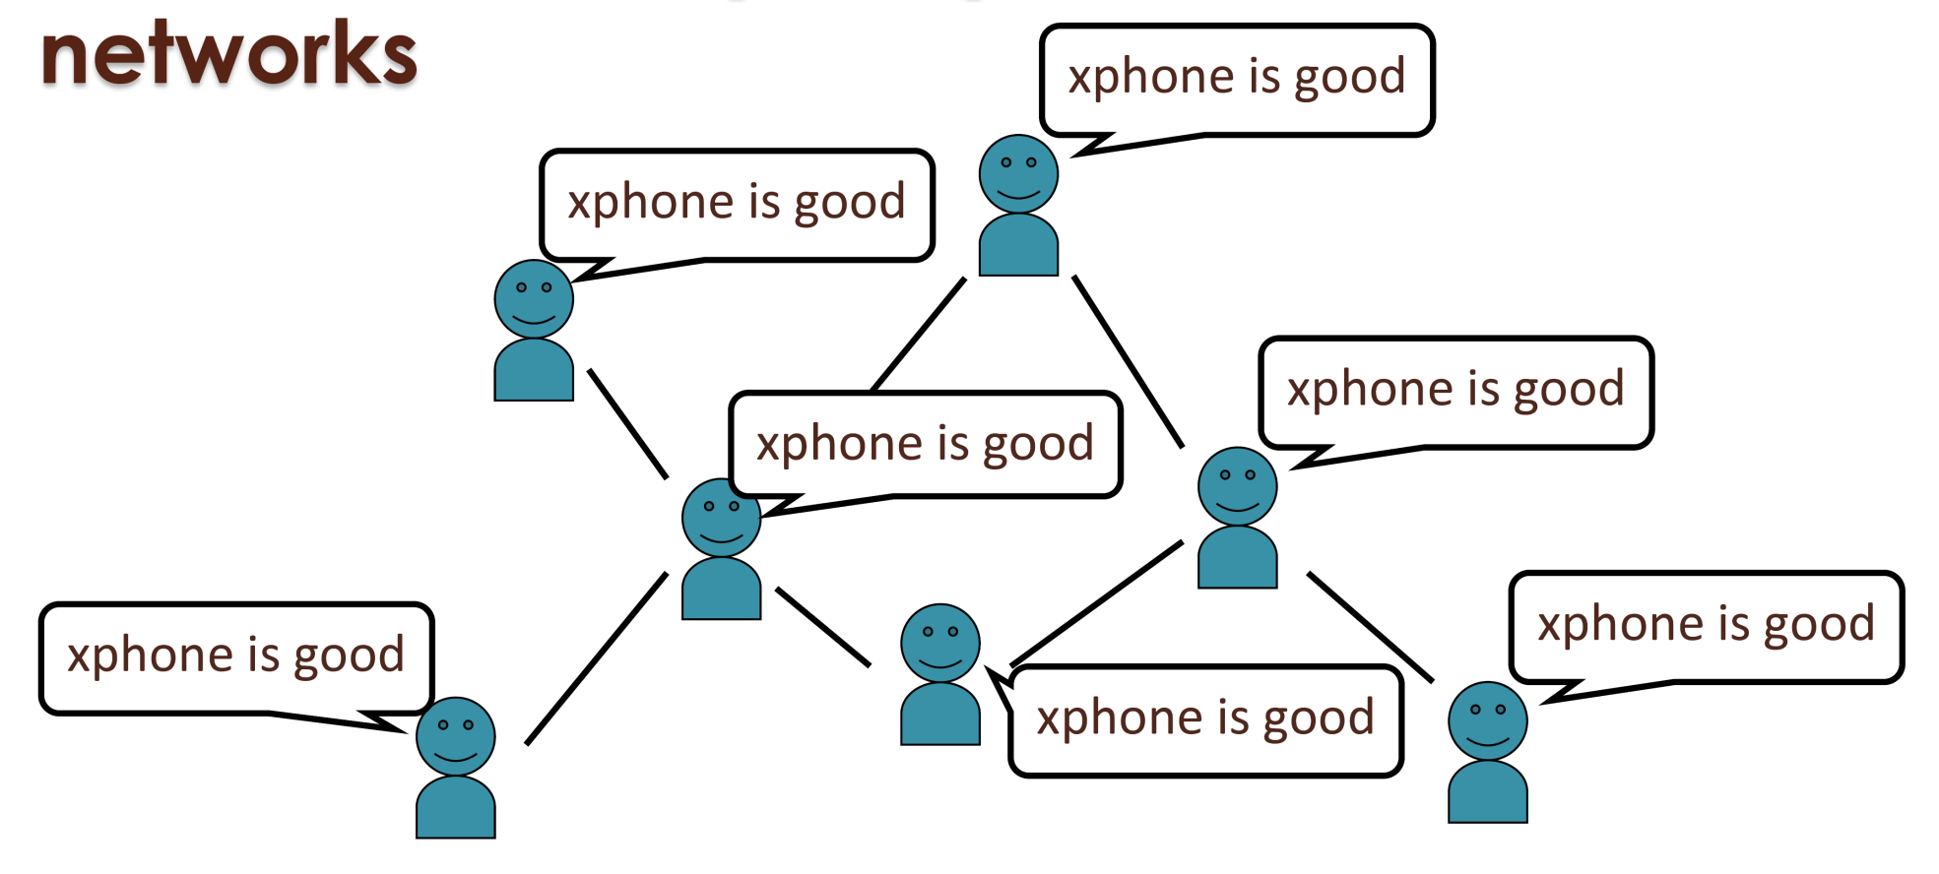
Application: Viral Marketing
[Castillo et al., KDD’12]

Slide 25
Properties of Influence Propagation
A social network is represented as a directed graph, with each actor being one node;
Each node is started as active or inactive;
A node, once activated, will activate his neighboring nodes;
Once a node is activated, this node cannot be deactivated.

Slide 26
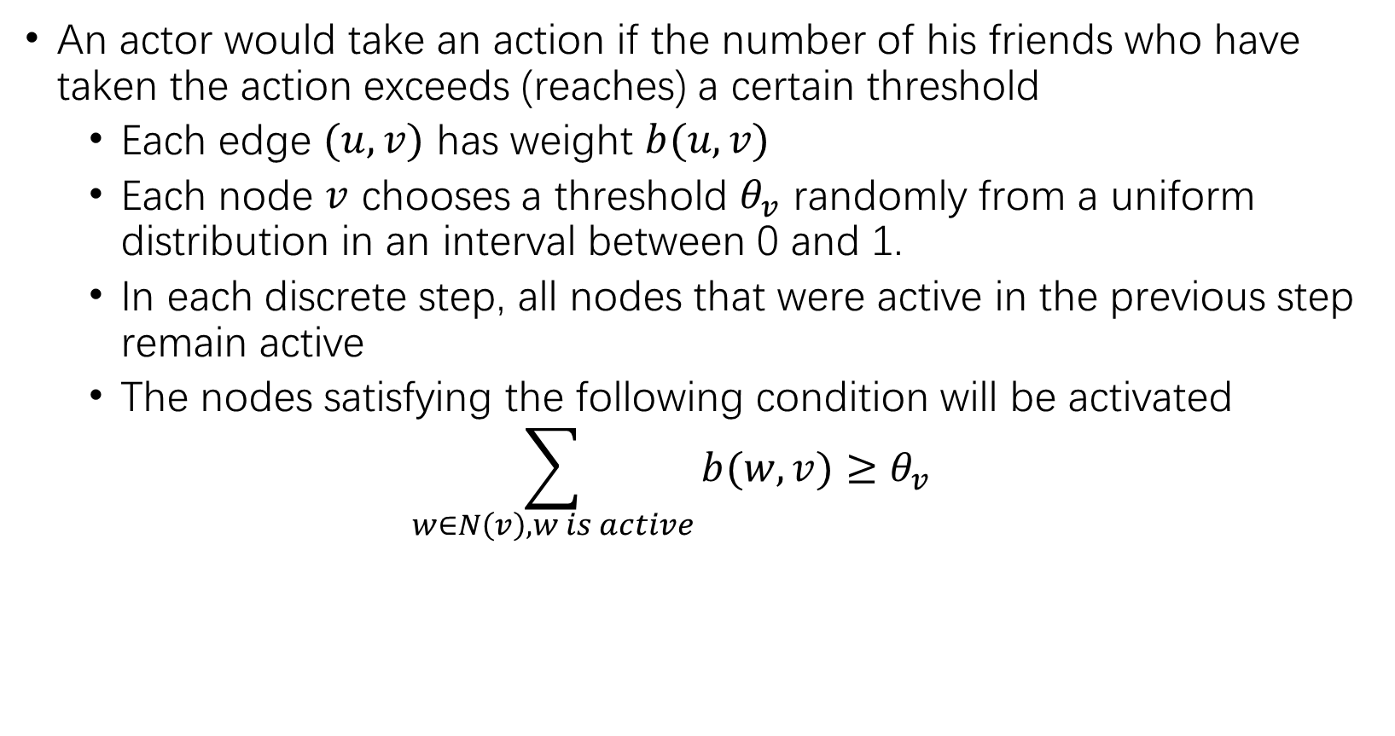
Linear Threshold Model
An actor would take an action if the number of his friends who have taken the action exceeds (reaches) a certain threshold
Each edge $(u,v)$ has weight $b(u,v)$
Each node $v$ chooses a threshold $θ_{v}$ randomly from a uniform distribution in an interval between 0 and 1.
In each discrete step, all nodes that were active in the previous step remain active
The nodes satisfying the following condition will be activated
$$\sum_{w∈N\left(v\right), w is active}{b(w,v)}≥θ_{v}$$

Slide 27
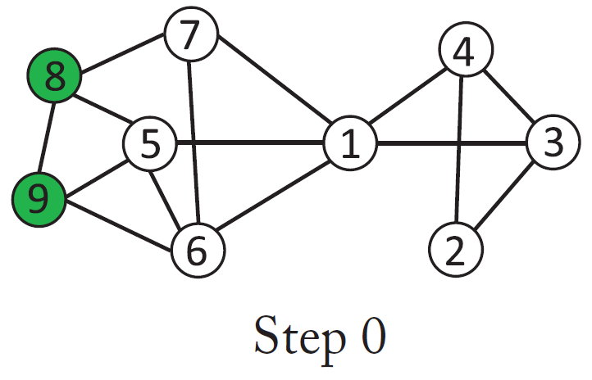
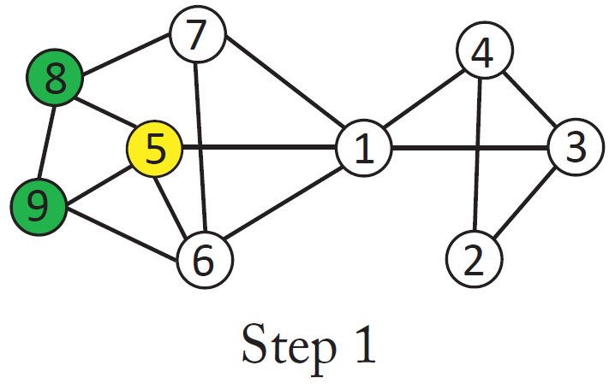
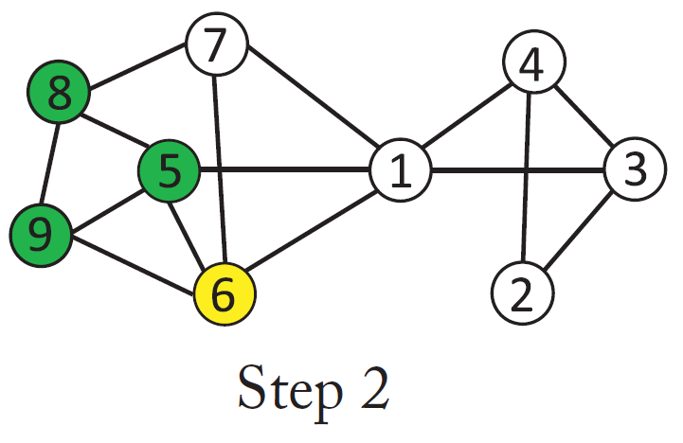
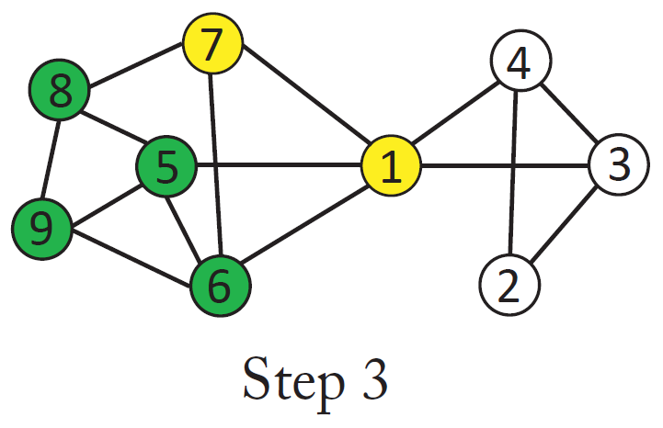
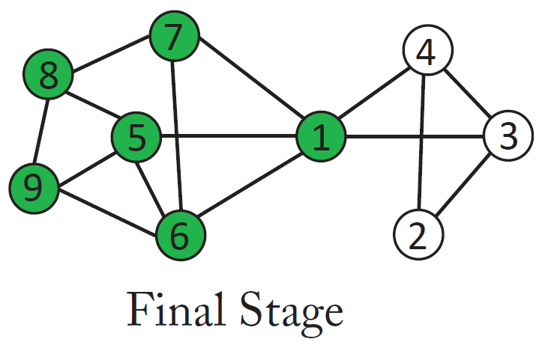
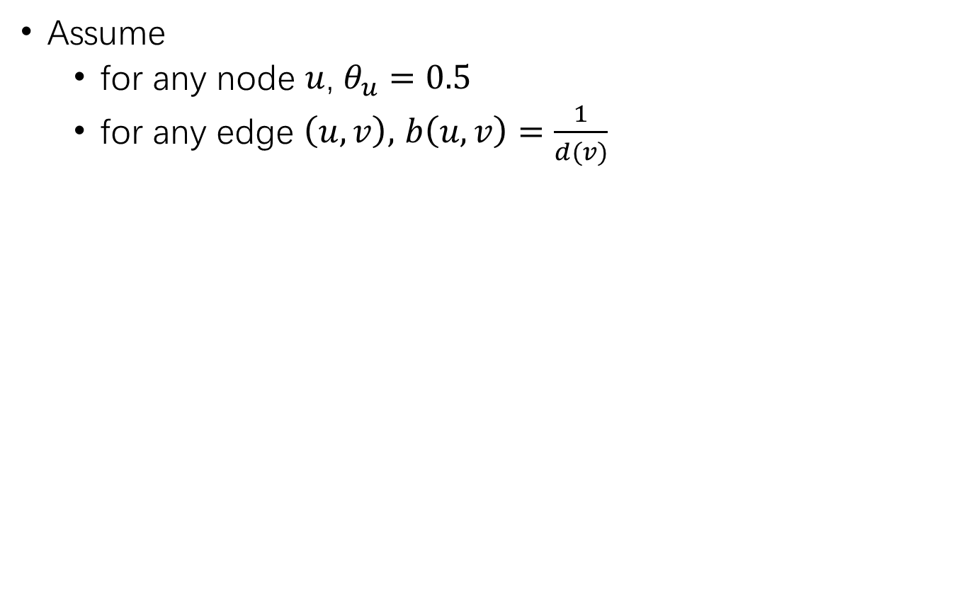
Diffusion Process
Assume
for any node $u$, $θ_{u}=0.5$
for any edge $\left(u,v\right),$ $b\left(u,v\right)=\frac{1}{d(v)}$
7
1
4

Slide 28
Independent Cascade Model
A node w, once activated at step t , has one chance to activate each of its neighbors randomly
For a neighboring node (say, v), the activation succeeds with probability p_{w,v} (e.g. p = 0.5)
If the activation succeeds, then v will become active at step t + 1
In the subsequent rounds, w will not attempt to activate v anymore.
The diffusion process, starts with an initial activated set of nodes, then continues until no further activation is possible

Slide 29
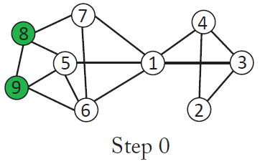
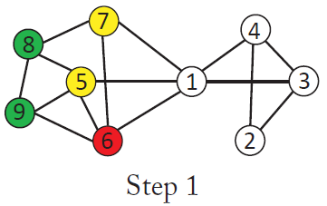
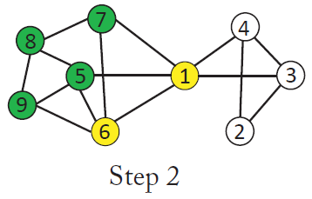
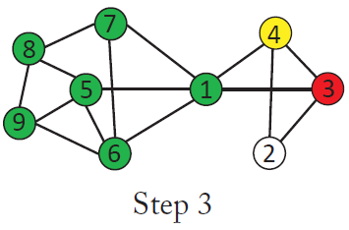
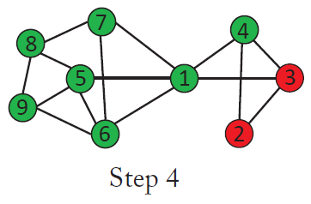
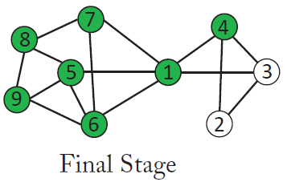
How does the Influence Spread?
Green node: active
Yellow node: activated successfully
Red node: failed to be activated

Slide 30
Graph Spectral Theory

Slide 31
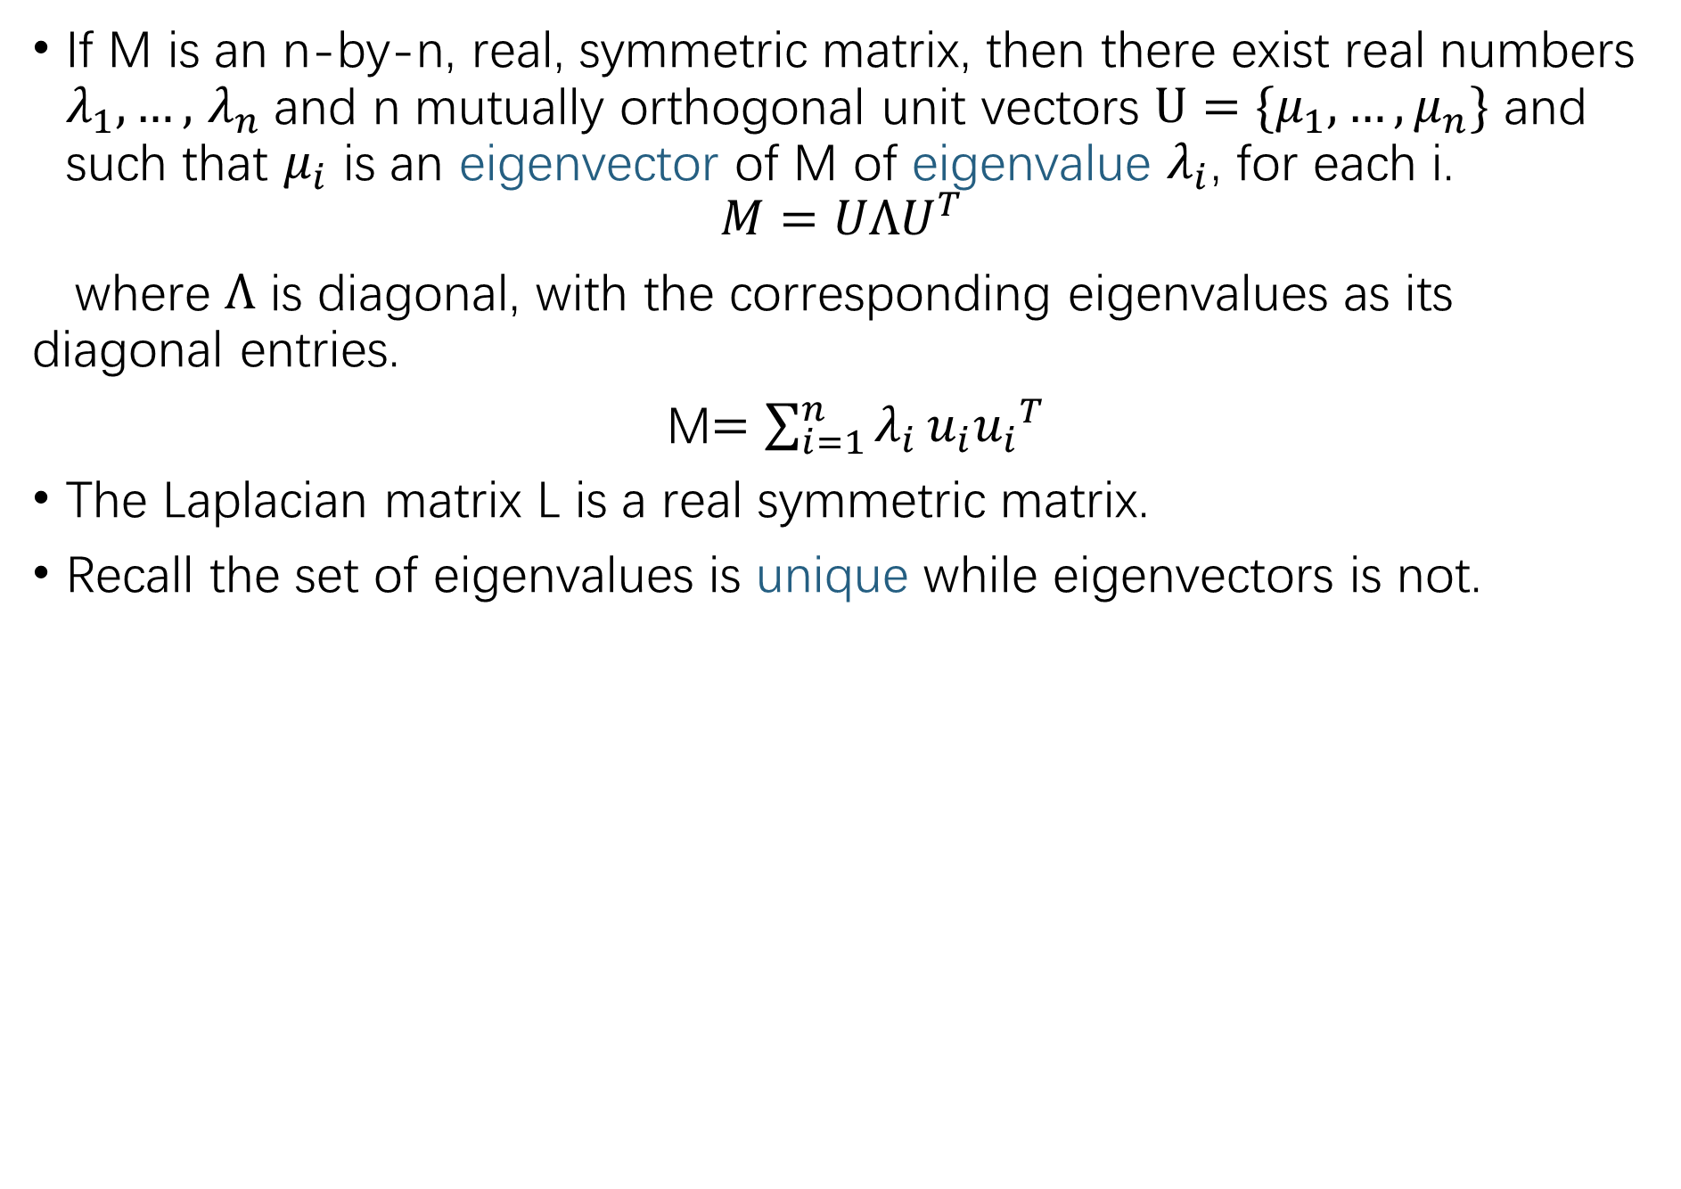
Graph Spectral Theory
If M is an n-by-n, real, symmetric matrix, then there exist real numbers $λ_{1},…,$ $λ_{n}$and n mutually orthogonal unit vectors $U=\{μ_{1},…,μ_{n}\}$ and such that $μ_{i}$ is an eigenvector of M of eigenvalue $λ_{i}$, for each i.
$$M=UΛU^{T}$$
where $Λ$ is diagonal, with the corresponding eigenvalues as its diagonal entries.
M$=\sum_{i=1}^{n}{λ_{i}}u_{i}{u_{i}}^{T}$
The Laplacian matrix L is a real symmetric matrix.
Recall the set of eigenvalues is unique while eigenvectors is not.
31

Slide 32
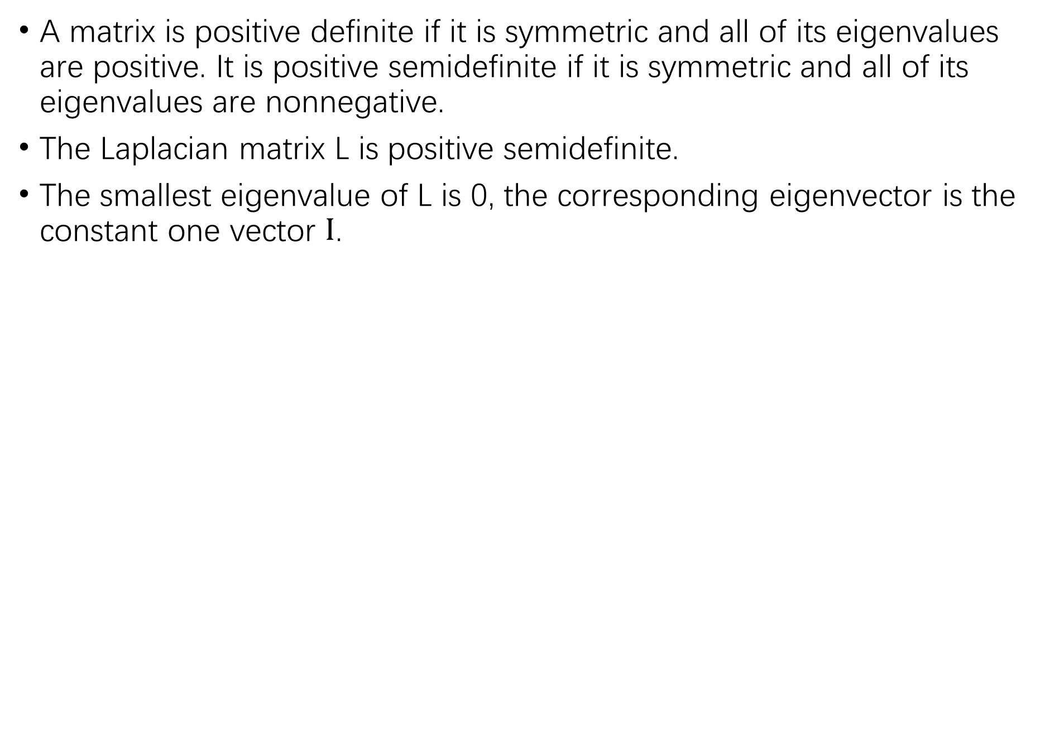
Graph Spectral Theory
A matrix is positive definite if it is symmetric and all of its eigenvalues are positive. It is positive semidefinite if it is symmetric and all of its eigenvalues are nonnegative.
The Laplacian matrix L is positive semidefinite.
The smallest eigenvalue of L is 0, the corresponding eigenvector is the constant one vector $Ι$.
32

Slide 33
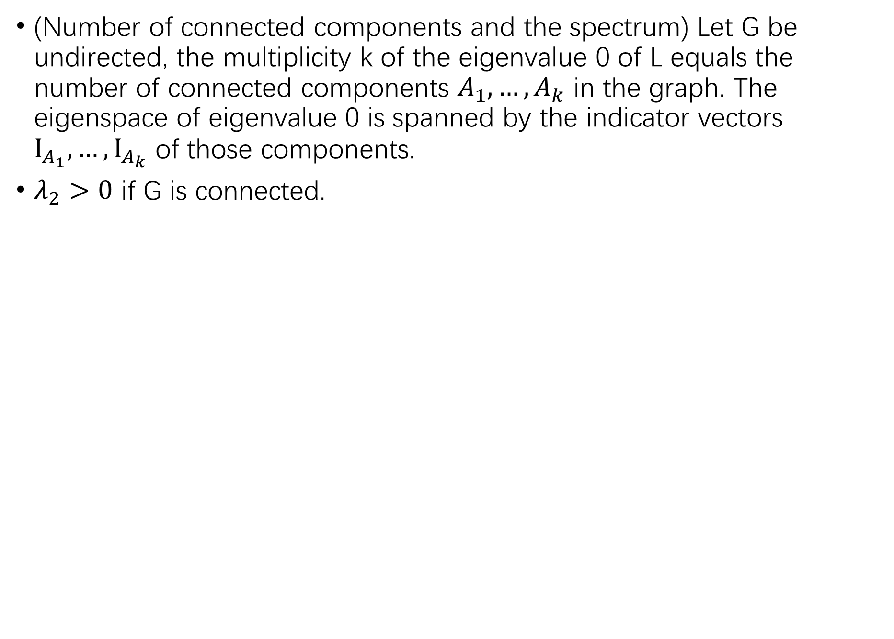
Graph Spectral Theory
(Number of connected components and the spectrum) Let G be undirected, the multiplicity k of the eigenvalue 0 of L equals the number of connected components $A_{1},…,A_{k}$ in the graph. The eigenspace of eigenvalue 0 is spanned by the indicator vectors $Ι_{A_{1}},…,Ι_{A_{k}}$ of those components.
$λ_{2}>0$ if G is connected.

Slide 34


Graph Spectral Theory
(Courant-Fischer Formula) For a graph G with Laplacian L,
$$λ_{2}= \min_{x⊥u_{1},x≠0}{\frac{x^{T}Lx}{x^{T}x}}$$
$$λ_{max}= \max_{x≠0}{\frac{x^{T}Lx}{x^{T}x}}$$

Slide 35
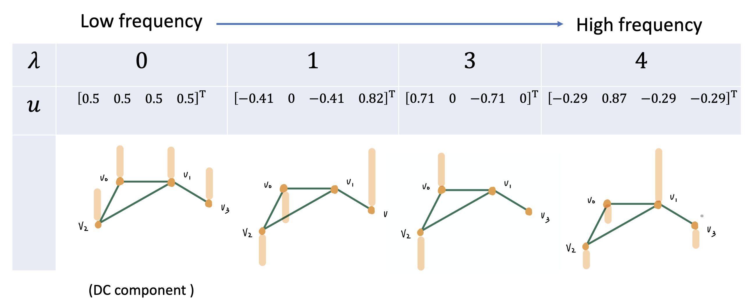
Graph Spectral Theory

Slide 36
Slides Credit
[1] Jure et al. graphs in Mining of Massive Datasets.
[2] Ulrike. A Tutorial on Spectral Clustering.
[3] Tan et al. Social Network in Introduction to Data Mining.
Notes:
transaction graph, node ,edge; IP, Device, phone NO,etc

